Slide 1

Image Segmentation with Deep Learning
Bianca Toto
CSC 550 Final Project
This Photo by Unknown Author is licensed under CC BY

Slide 2
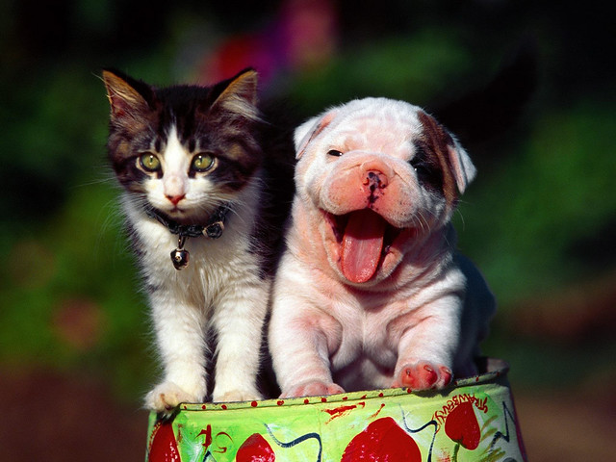
Project Overview
This project utilizes the pretrained keras VGG-16 Model to implement the Full-Convolutional Network for Image Segmentation
Implementation
Implementation of FCN-8 uses TensorFlow, NumPy, and SciPy libraries
Oxford-IIT Pet Dataset
Composed of images with corresponding labels and pixel-wise masks that are labels for each pixel
Three-pixel categories:
Class 1: Pixel belonging to pet
Class 2: Pixel bordering the pet
Class 3: None of the above/ Surrounding Pixel

Slide 3

Research Questions
Image segmentation trains a neural network to output a pixel-wise mask of the image to give a lower-level understanding of the image.
What is VGG-16?
What is FCN-based segmentation?
VGG16 is a convolutional neural network architecture that is 16 layers deep
By only keeping the convolutional modules, it can be adapted to arbitrary input sizes.
The model loads a set of weights pre-trained on ImageNet
FCN segmentation is an approach that maps from pixels to pixels without extracting region proposals.
FCNs utilize convolutional and pooling layers to make low resolution predictions

Slide 4
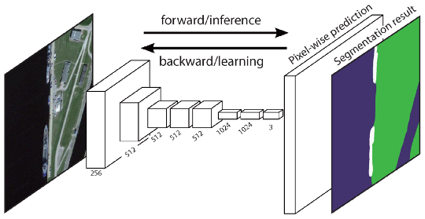
FCN Architecture
The FCN transfers the knowledge of the segmentation process.
Convolution is used to convert the connected layers of VGG16 to convolutional layers for a class presence heat map.
The low resolution maps are upsampled with transposed convolutions.
To refine further, features are added from coarser, higher resolution maps from VGG16 lower layers

Slide 5
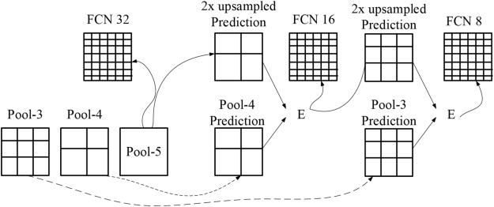
FCN-8
Encoder: A pre-trained VGG-16 model
Decoder: Starts from Layer 7 of VGG-16
FCN Layer-8: last fully connected layer replaced by convolution
FCN Layer-9: FCN Layer-8 upsampled 2x to match dimensions of Layer4 VGG-16 using transposed convolution
skip connection Layer4 and Layer9
FCN Layer-10: FCN Layer-9 upsampled 2x to match dimensions of Layer3 VGG-16 using transposed convolution
skip connection Layer3 and Layer10
FCN Layer-11: FCN Layer-10 is upsampled 4x to match dimension with input image size so we get the actual image back using transposed convolution

Slide 6
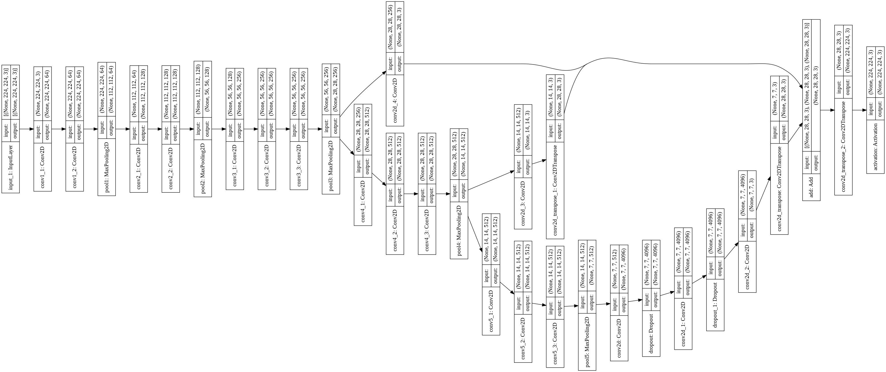
Model Summary 1

Slide 7
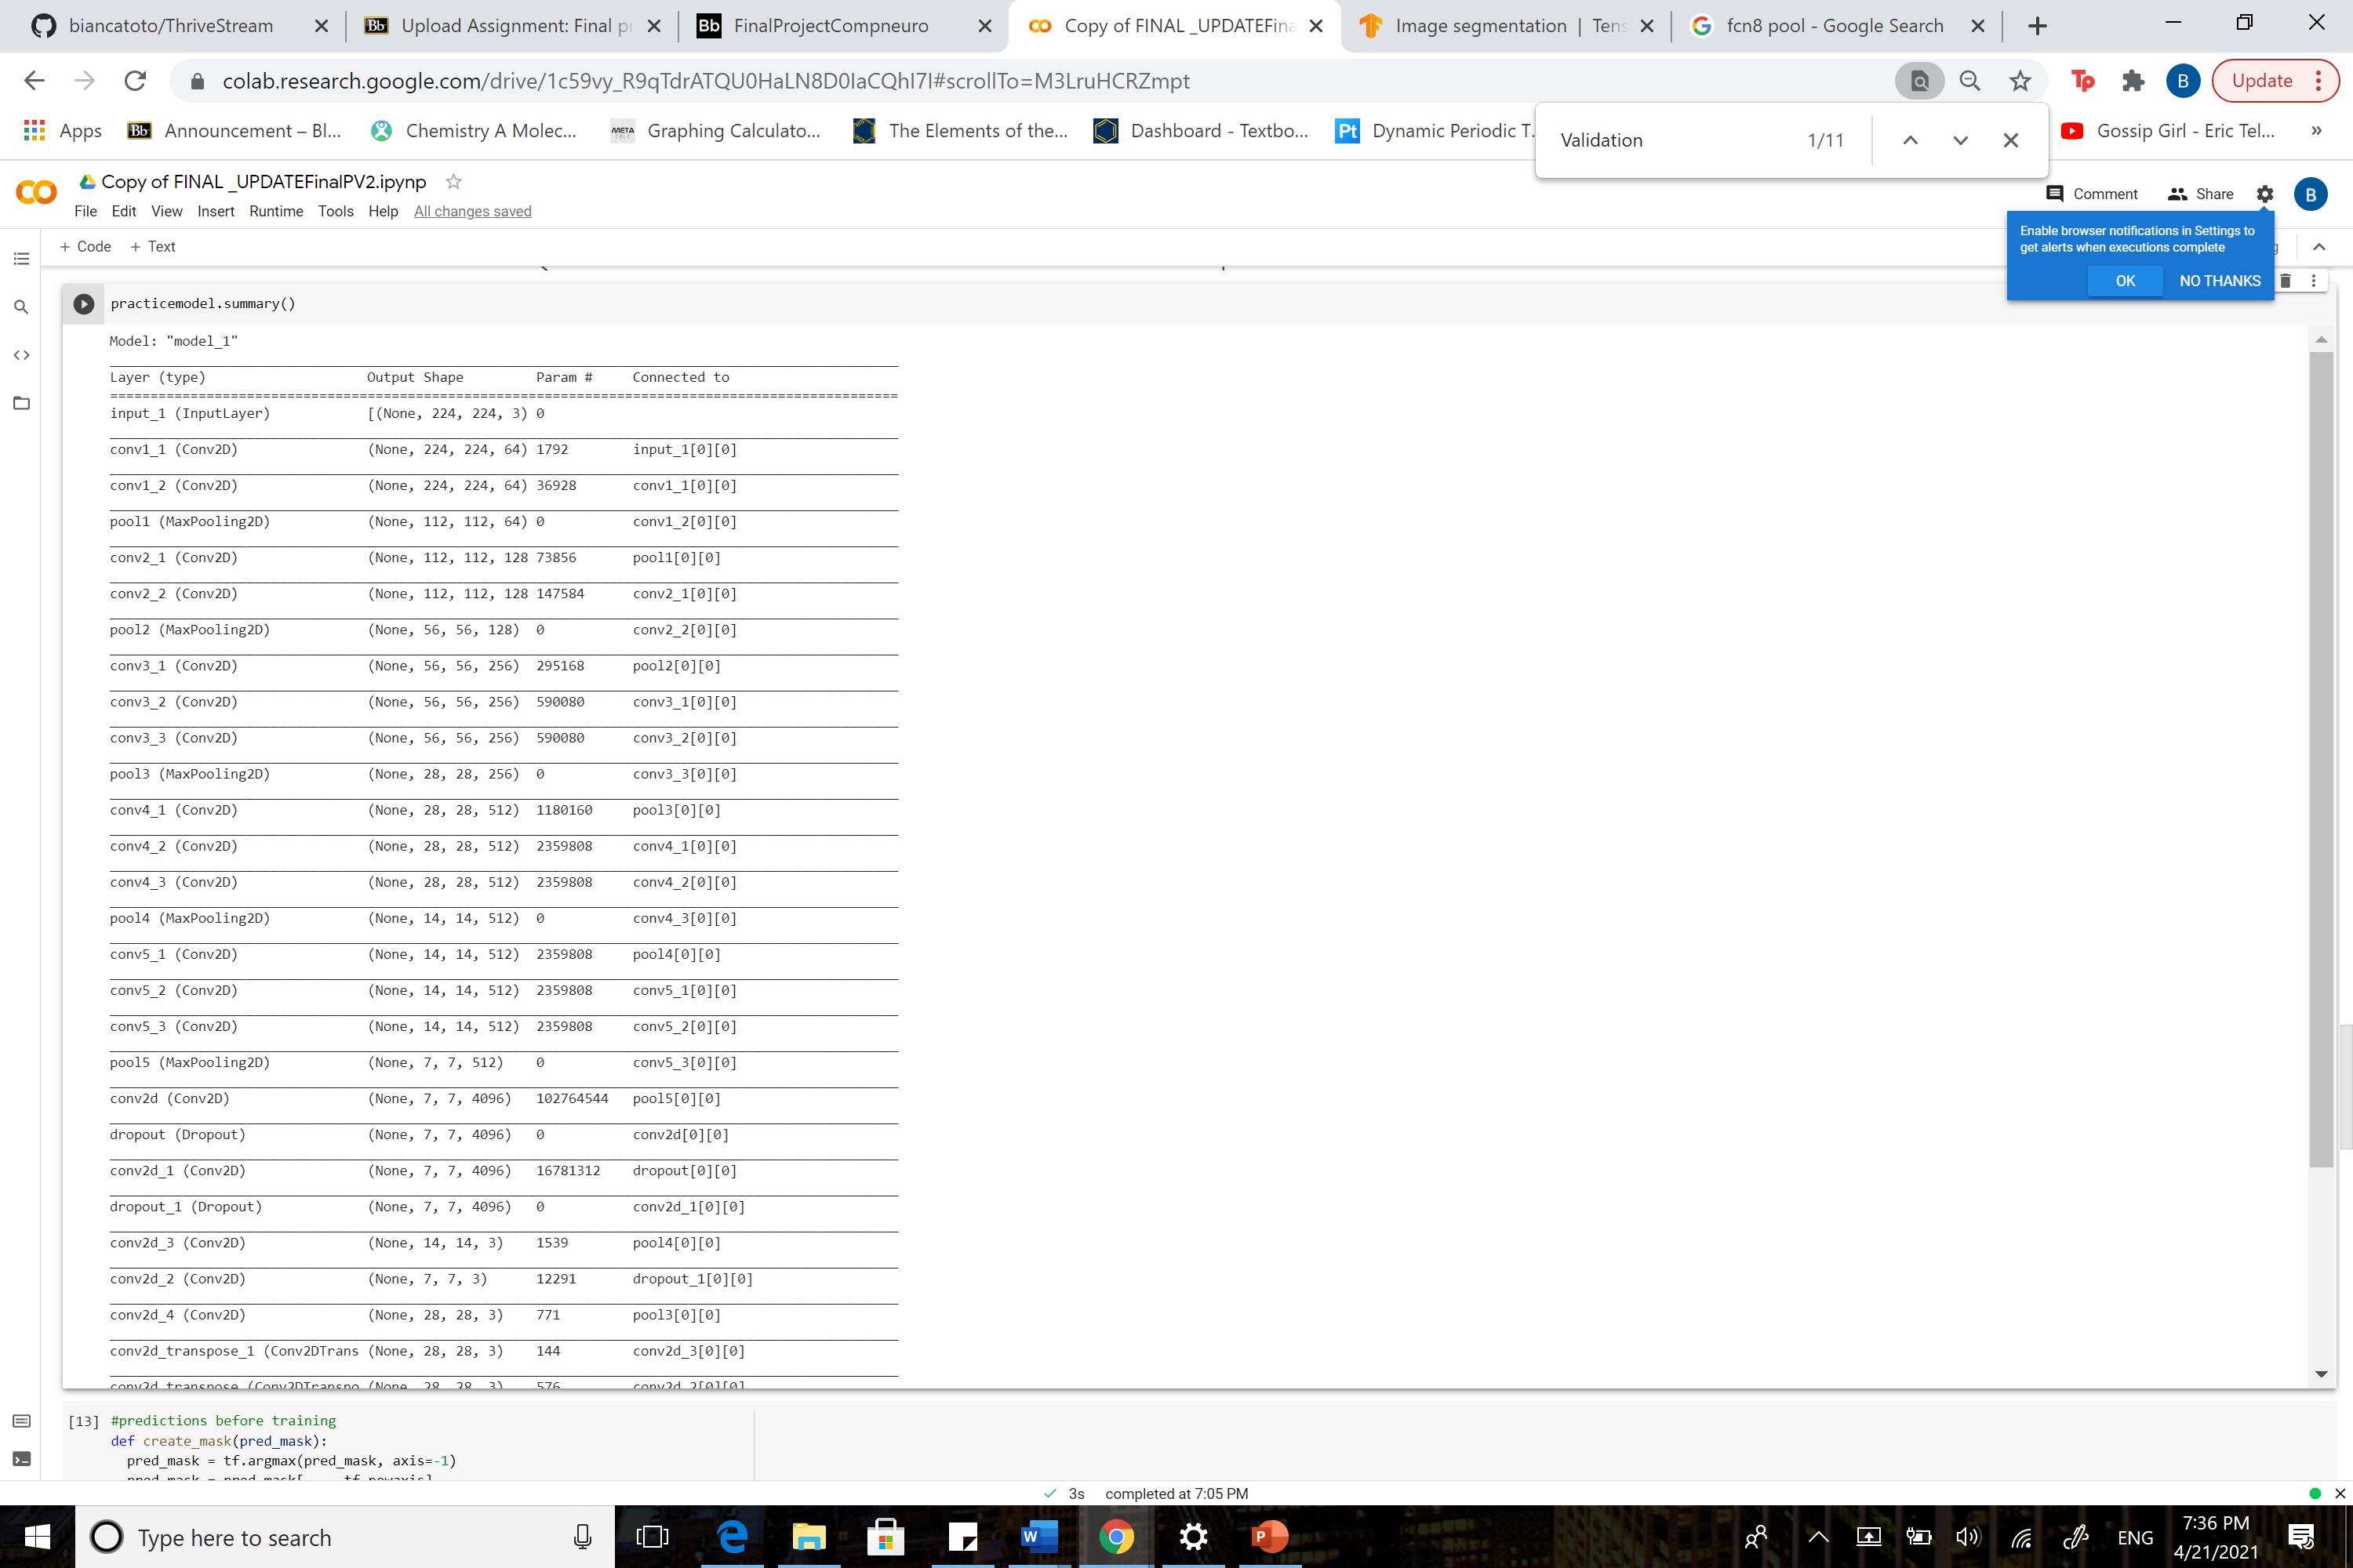

Model Summary 2
Image 1. Input to conv5_3 Image 2. pool5 to end

Slide 8
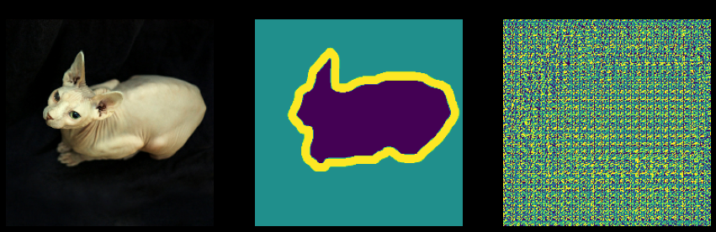
Prediction Before Training
Input Image, True Mask, Predicted Mask

Slide 9
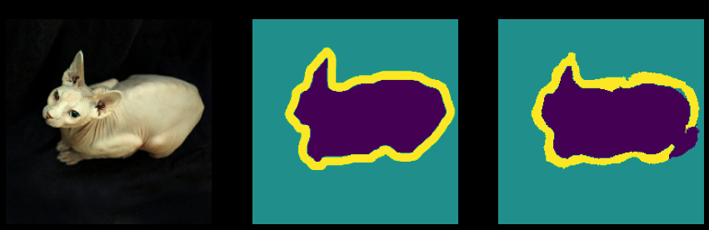
Sample Prediction After 20 Epochs
Input Image, True Mask, Predicted Mask

Slide 10
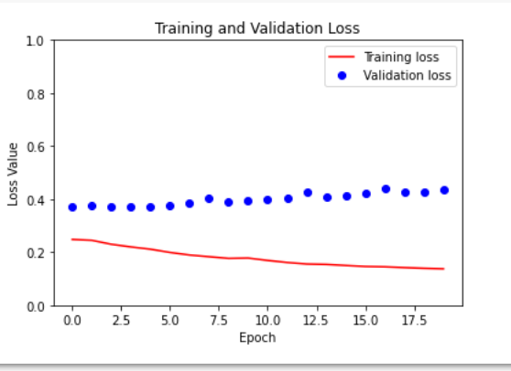
Training and Validation Loss

Slide 11
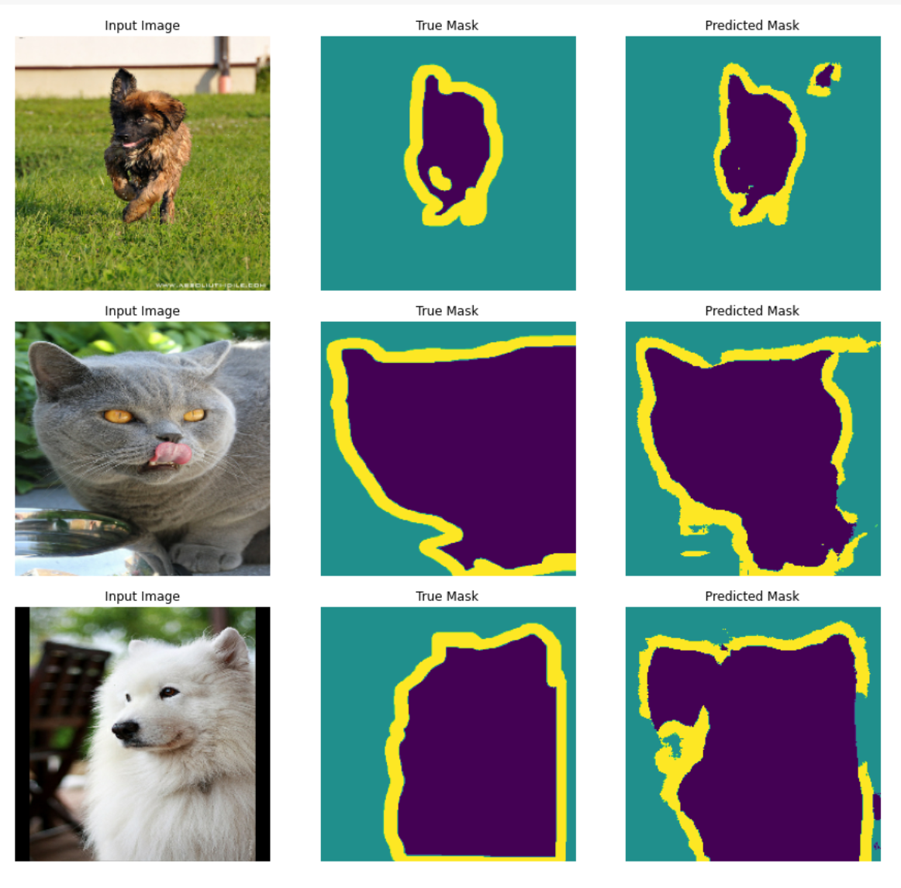
Predictions with Test Data Set

Slide 12
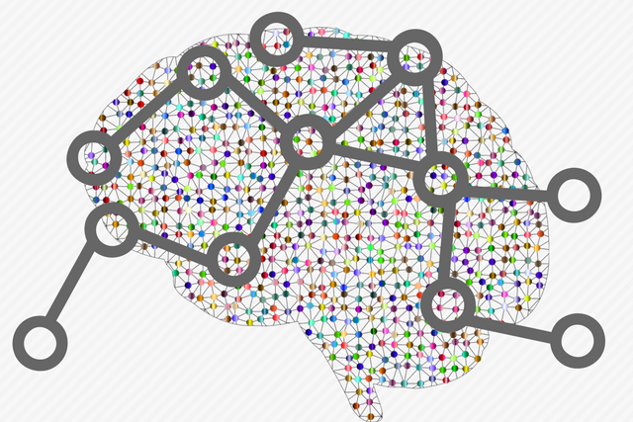
Thank You!
Thank you to Prof. Schwartz and CSC550 students.
Email for code: bianca.toto03@gmail.com
This Photo by Unknown Author is licensed under CC BY

